Slide 1

Final Project ML Classification: Heart Disease Prediction
IBM Machine Learning Professional Certificate
Course 03: Supervised Machine Learning: Classification
By Mohamad Osman

Slide 2

Contents
Dataset Description
Main objectives of the analysis.
Applying various classification models.
Machine learning analysis and findings.
Models flaws and advanced steps.

Slide 3
Data Description Section

Slide 4
Introduction
Predicting and diagnosing heart disease is one of the major challenges in the medical industry as it depends on several factors including physical examination and various symptoms and signs present in the patient. Heart disease is considered as one of the deadliest disease in the world for human life due to the heart's inability to push the required amount of blood to other body organs to perform the regular functions in the human body. There are several factors affecting heart disease include but not limited cholesterol levels in the body, smoking habits and obesity, family history of diseases, blood pressure, work environment and others. Today, ML Algorithms play an essential and accurate role in heart disease prediction. Rapid advances in technology allow Machine Language to integrate with Big Data tools to manage the exponentially growing unstructured data that includes medical data for patients around the world. Heart disease can be predicted based on different symptoms like age, gender, heart rate etc. which in turn reduces the death rate for heart patients. In this report we are going to use machine learning algorithms and Python language to do that!

Slide 5
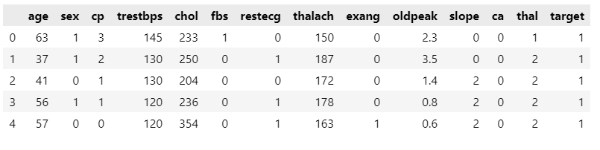
Dataset Description 01
age: The person’s age in years
sex: The person’s sex (1 = male, 0 = female)
cp: chest pain type: Value 0: asymptomatic Value 1: atypical angina Value 2: non-anginal pain Value 3: typical angina
trestbps: The person’s resting blood pressure (mm Hg on admission to the hospital).
chol: The person’s cholesterol measurement in mg/dl.
fbs: The person’s fasting blood sugar (> 120 mg/dl, 1 = true; 0 = false).

Slide 6
Dataset Description 02
restecg: resting electrocardiographic results Value 0: showing probable or definite left ventricular hypertrophy by Estes’ criteria Value 1: normal Value 2: having ST-T wave abnormality (T wave inversions and/or ST elevation or depression of > 0.05 mV).
thalach: The person’s maximum heart rate achieved.
exang: Exercise induced angina (1 = yes; 0 = no)
oldpeak: ST depression induced by exercise relative to rest (‘ST’ relates to positions on the ECG plot. See more here)
slope: the slope of the peak exercise ST segment
0: upsloping; 1: flat; 2: downsloping
ca: The number of major vessels (0–3)
thal: A blood disorder called thalassemia
Value 0: NULL (dropped from the dataset previously Value 1: fixed defect (no blood flow in some part of the heart) Value 2: normal blood flow Value 3: reversible defect (a blood flow is observed but it is not normal)
target: Heart disease (0 = no, 1= yes)

Slide 7
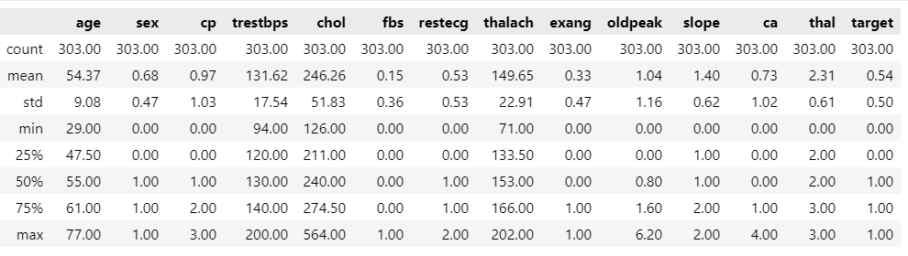


Dataset Description 02

Slide 8
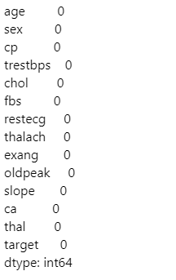

Dataset Description 03
Checking for Null values
Great, there is no missing values within our features !

Slide 9
Data Analysis Section

Slide 10
Main Objective of the analysis:
In this section I am showing the correlation between the features to find the most influence features on our target which is Target (Heart Disease Existence).
After that I am building different Classification models based on advanced techniques such as GridSearch, ML pipelines, and Hyperparameters tuning to get the best predictive model in terms of accuracy, in addition of what are the flaws of each model.

Slide 11

Data Analysis 01
- Identifying categorical features and continuous features:

Slide 12
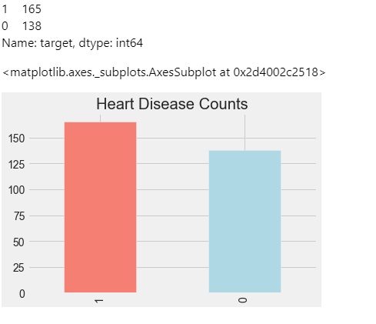
Data Analysis 02
Viewing the status of people in the data set :
We have 165 people with heart disease and 138 healthy people, so the data for the target variable we want to predict is in balance.

Slide 13
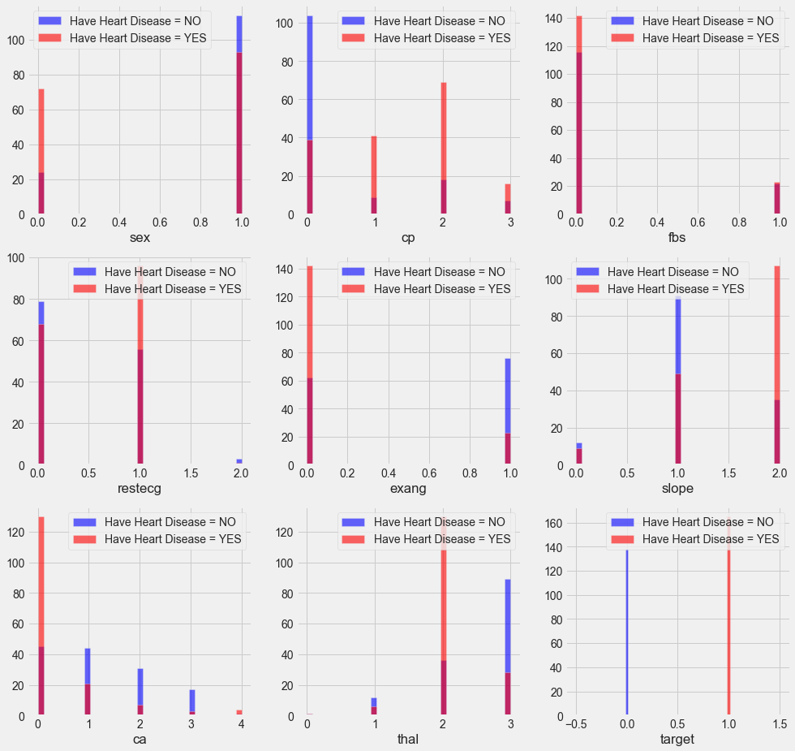
Data Analysis 03
Study of the relationship of categorical features and heart disease:
cp (chest pain): people with chest pain of the type: cp: [1, 2, 3] tend to have more heart disease than people without any chest pain cp: 0
restecg (resting ECG results): People with a value of 1 (having an abnormal heart rhythm, which can range from mild symptoms to severe problems) are more likely to develop heart disease.
exang (exercise-induced angina): People with non-exercise-induced angina who have a value of 0 are more likely to have heart disease than those who have exercise-induced angina with a value of 1.

Slide 14
Data Analysis 04
Slope (rectal slope for the ST segment of peak exercise): People with a downsloping slope of 2 have signs of an unhealthy heart therefore they more likely to have heart disease than people with an upsloping of 0 or a flat slope A value of 1: minimal change (typical healthy heart)).
ca (number of blood vessels (0-3) ): the more blood flow the better heart, so people with a vessel number ca equal to 0 are more likely to have heart disease.
thal (a blood disorder called thalassemia): People with a thal value = 2 are more likely to have heart disease.

Slide 15
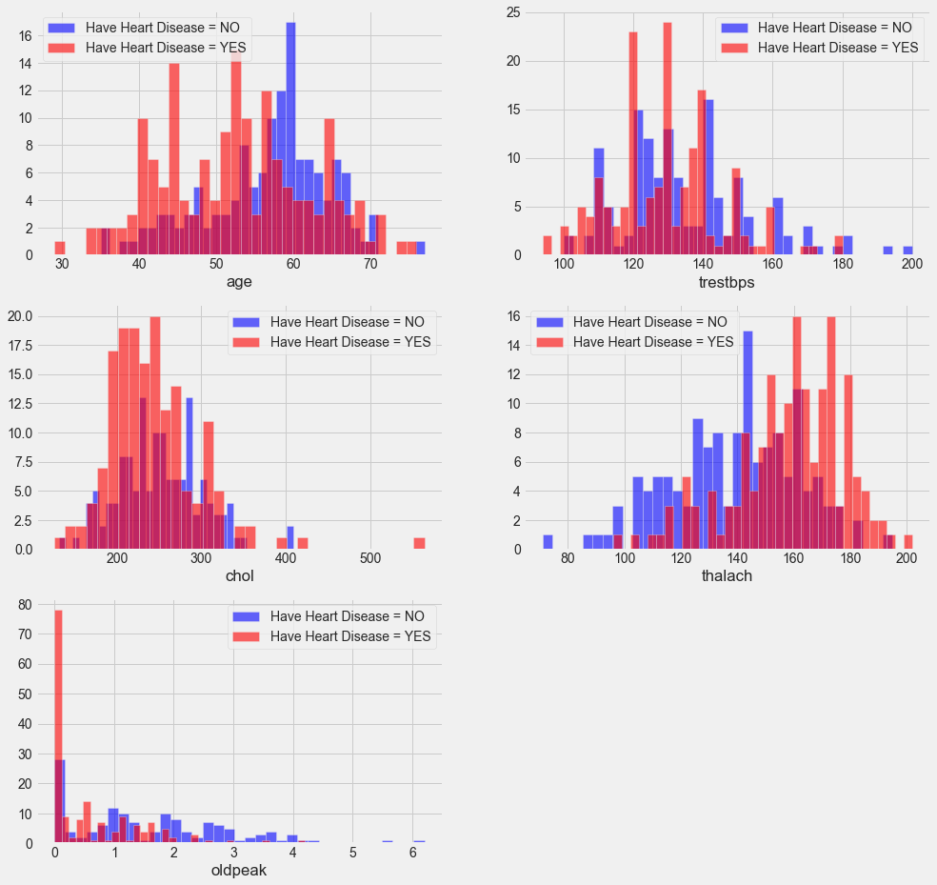
Data Analysis 05
Study of the relationship of continuous features and heart disease:
trestbps: When blood pressure is higher than 130-140 mm Hg, this is a cause for concern.
chol: When cholesterol is higher than 200 mg/dL, it is a very dangerous indicator, as shown in the graphic above.
thalach: People with a heart rate above 140 are more likely to have heart disease.

Slide 16
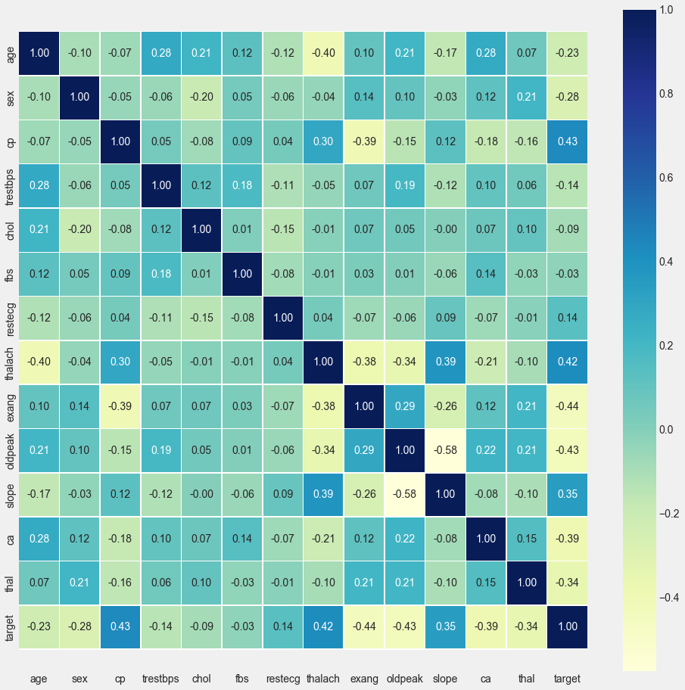
Data Analysis 06
- Studying the correlations between features using Heat Map!
The goal of this matrix is to show the relationship between features, and this is useful for feature engineering techniques, but what matters most to us in this lesson is the relationship between the target variable (knowing whether a person has a heart disease or not) and the rest of the features, meaning that our focus will be on the last row from the matrix.
1. fbs and chol are the features least related to the target variable.
2. All other features have a high correlation with the target variable.

Slide 17
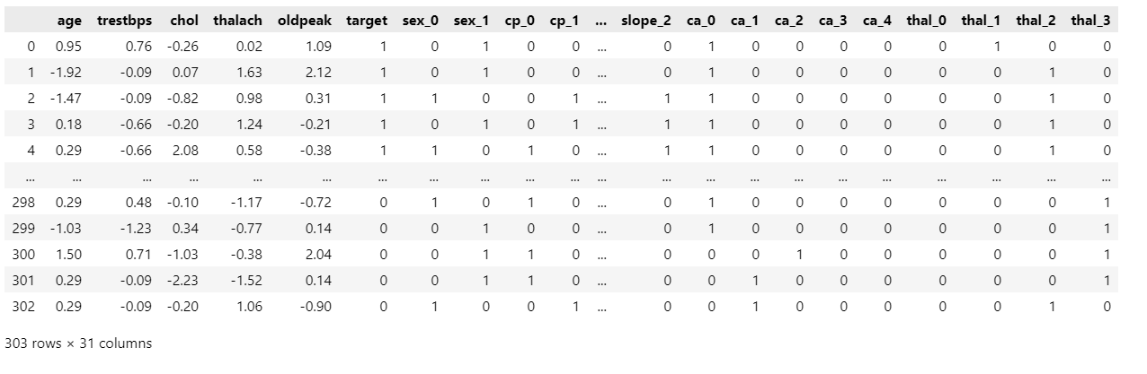
Feature Engineering 01
Converting Categorical features into Numerical features :

Slide 18
Machine Learning Analysis & Findings

Slide 19
Machine Learning Analysis & Findings
In the following analysis will compare between 4 different Classification models Logistic Regression, KNN, SVM and XGBoost in terms of predicting the Heart Disease. Where I am going to use the following techniques to help me in developing robust models:
Standard scaling, cross-validation method, Grid Search, metric measurements such accuracy, precision, F1 Score etc.

Slide 20
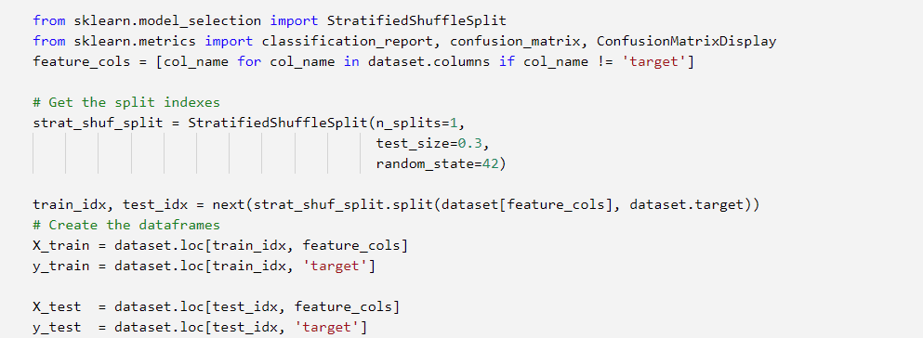
Machine Learning Analysis 01
Data Splitting:

Slide 21
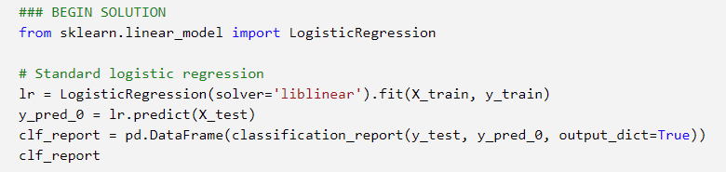
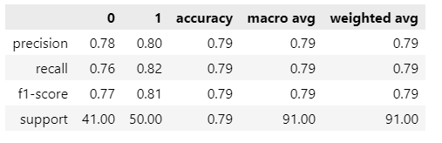
Machine Learning Analysis 02
Logistic Regression Model:

Slide 22
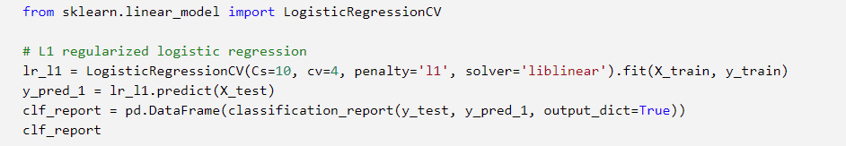
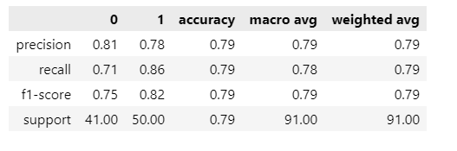
Machine Learning Analysis 03
Logistic Regression Model with penalty = L1:

Slide 23
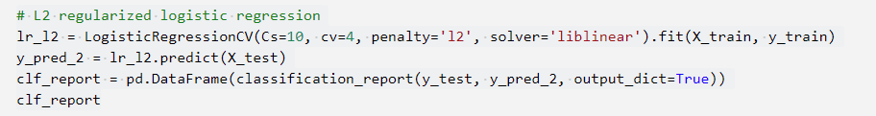
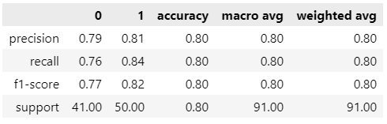
Machine Learning Analysis 04
Logistic Regression Model with penalty = L2:

Slide 24
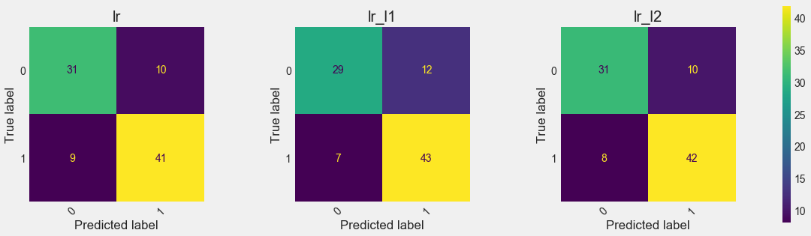
Analysis & Findings
Logistic Regression Models Findings:
The best model in terms of prediction performance is Logistic Regression with penalty = 2
Accuracy : 80%
Precision : 80%
Recall : 80%
F1-score : 80%
Support : 91%

Slide 25
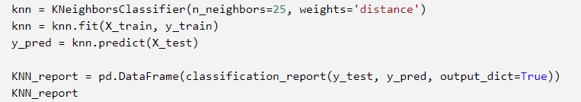
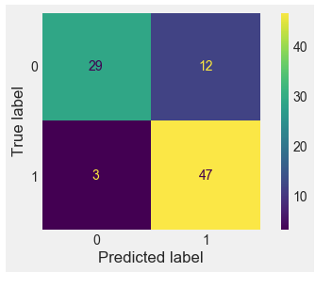
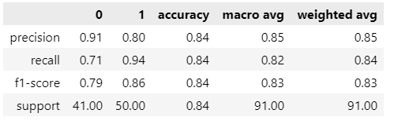
Machine Learning Analysis 05
KNN Algorithm
Accuracy : 84%
Precision : 85%
Recall : 84%
F1-score : 83%
Support : 91%

Slide 26
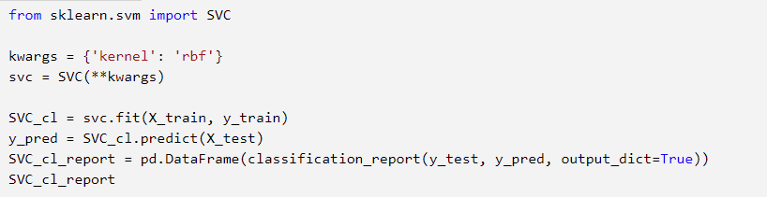
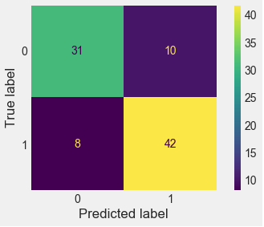
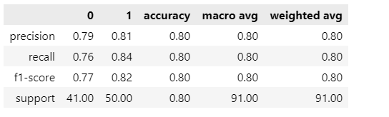
Machine Learning Analysis 06
Support Vector Machine Model:
Accuracy : 80%
Precision : 80%
Recall : 80%
F1-score : 80%
Support : 91%

Slide 27
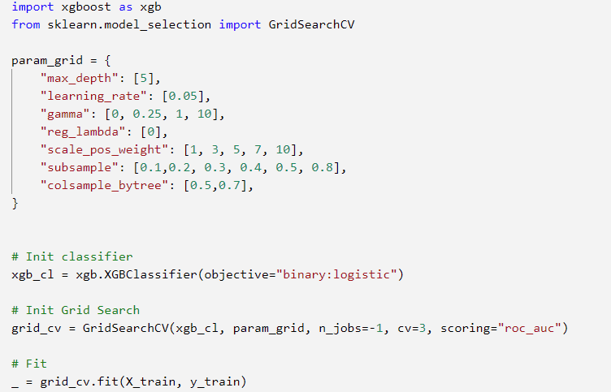
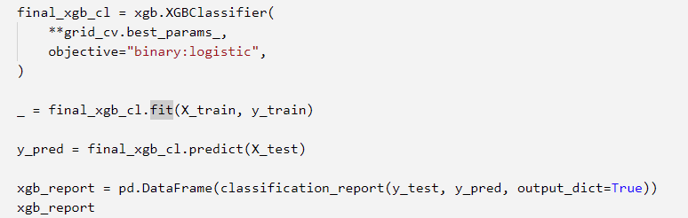
Machine Learning Analysis 07
XGBoost Algorithm

Slide 28
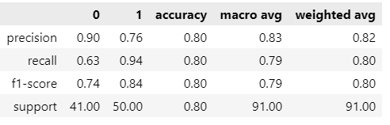
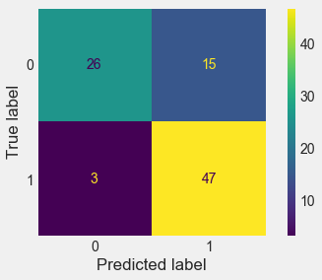
Machine Learning Analysis 08
XGBoost Algorithm
Accuracy : 80%
Precision : 82%
Recall : 80%
F1-score : 80%
Support : 91%

Slide 29
Machine Learning Analysis 09
XGBoost Algorithm
Accuracy : 80%
Precision : 82%
Recall : 80%
F1-score : 80%
Support : 91%

Slide 30

Machine Learning Analysis 10
Models Comparison
As shown in the previous analysis all the models provide very good prediction results and these results are so close to each other, But at the end we must choose one model for our dataset
and this depends on the highest result.
Below I ordered the models descending:
1- KNN
2- XGBoost
3- Logistic Regression with L2
4- Support Vector Machine
KNN

Slide 31
Models flaws and strengths and advanced steps

Slide 32
Machine Learning Analysis 11
Models Flaws and Strength and further suggestions:
In terms of simplicity, we can say Logistic Regression provided high predictive results and at the same time it is the simplest and fastest Model in terms of parameters and training but if we look to other models like KNN it is providing the best results, but it is slower in terms of prediction process because it requires to calculate the distance between all the points in the dataset to classify every single point. XGBoost performance was very good as well but in contrast of KNN it takes longer time in the training process since we used grid search technique to search about best fitting parameters, so at the end it is a tradeoff if we have bigger dataset then the performance will be higher with such models, but the training process will take a longer time.

Slide 33
Thank you
IBM Machine Learning Professional Certificate
Supervised Machine Learning: Classification
By: Mohamad Osman

